Slide 1

Physical Data Model Tuning
Level-Advanced
C3: Protected

Slide 2

About the Author
Created By: | Anirudhan Velur (142252)
Credential Information: | Senior Architect More than 13+ years experience
Version and Date: | DM/PPT/0209/1.0
Cognizant Certified Official Curriculum

Slide 3









Icons Used
Hands on Exercise
Questions
Tools
Coding Standards
Test Your Understanding
Reference
A Welcome Break
Contacts
Demonstration

Slide 4
Physical Data Model Tuning : Overview
Introduction:
This chapter provides the overview of Physical Data Model Tuning Techniques.

Slide 5
Physical Data Model Tuning : Objectives
Objective:
After completing this chapter you will be able to:
Explain the objectives of Physical Data Model Design
Explain De-normalization and its Techniques
Explain Partitioning

Slide 6
Physical Data Model Tuning
The Basic Aim for Physical database design Tuning are:
Avoid unnecessary I/O; data must be written or read from the database as efficiently as possible
Allow for table growth
Avoid excessive overhead on data insert/update
Avoid unnecessary database/table maintenance problems
Achieve predefined performance targets
Avoid data/index block hot spots
Work well within the deployment environment constraints

Slide 7
Physical Data Model Tuning (Contd.)
The inputs into the Physical design activity are as follows:
Logical model (output from any analysis work)
Usage Model (how the data will be accessed or used)
Volumetrics (how much data)/Sizing The Model
Performance requirements /Non Functional Requirements [Language Support]
DBMS Specific Features
Audit Requirements

Slide 8
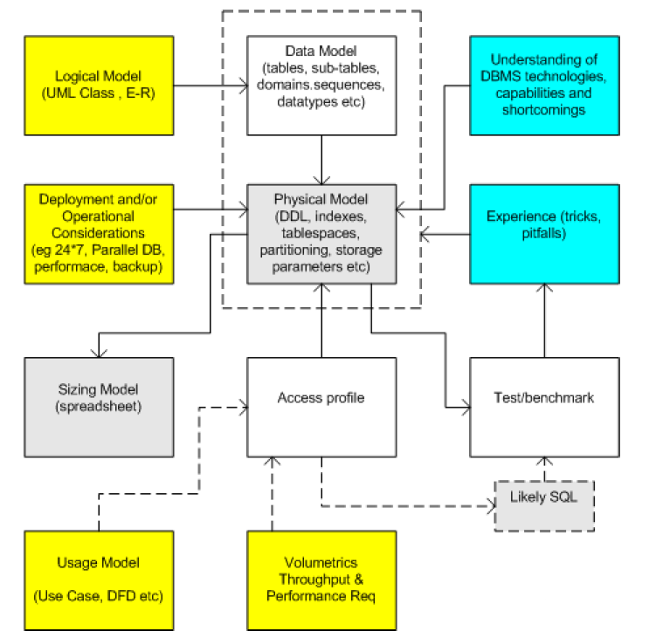
Physical Data Model Tuning (Contd.)

Slide 9
Physical Data Model Tuning (Contd.)
Before Design a Physical Model understand the System deployment requirements/constraints
Deployment conditions can heavily impact the physical database design.
For example, a 24*7 shop will have few downtime windows for database maintenance such as table/index restructuring.
Understand exactly what is required. This might include, amongst others things.
A parallel implementation : Oracle RAC or grid ? (hot spot shared data/index blocks and locking may be an issue)
24 * 7 (online index rebuilds and other object restructuring)
Performance requirements (max response times, priorities) Backup/recovery (static tables, read only components)
Database maintenance windows ( time to re-organize a large table or index)
Replication specific requirements ( often require a Primary key or OID or supplemental logging, possibly do not support all datatypes : LOBs and so on)

Slide 10
Physical Data Model Tuning (Contd.)
Data Access Profiles:
An access profile -Each transaction or activity will manipulate rows of data and an overview of the different types of transactions against tables.
Each logical business transaction or UML Sequence Diagram (even Use Case) in our usage model can be broken down into several references to tables within our data model. These approximate to potential SQL statements or groups of SQL.
Data Access profiles are extremely useful in database design ( pretty much obligatory for any serious completive bench marking) but are often ignored .
Access profiles can be generated for any one of the following:
All business/service interactions
Crucial or key interactions

Slide 11
Physical Data Model Tuning (Contd.)
Creating Access Profiles:
Use a spreadsheet to create an access profile with the following columns
Interaction/function
For example: get customer details
Relative Priority (critical, high, med, low)
Table
For example: cust
SQL access type
For example: unique key , key range or scan
Likely SQL (even if multi table)
For example: select......
Table rows/ SQL restricted on :
For example: cust_id, , *, namely ‘XYZ%’
Rows manipulated
For example: 30
Frequency (per hour or day and so on)
For example: 20/sec

Slide 12
Physical Data Model Tuning (Contd.)
Output of Data Access profiles should clarify or indicate
The crucial SQL (useful for benchmarking)
Potential index keys
Join keys
Potentially updateable keys
Potential IO clustering
Relative workload against tables
Table storage parameters (for tables with a lot of updates)
Data/index hotspots
Data or index ordering importance or issues
Surrogate keys
Static tables /MV

Slide 13
Physical Data Model Tuning (Contd.)
Sizing Models:
The sizing of the database ( or more precisely, the schema objects in the database) is DBMS specific and its calculation requires the exact physical model to be known
Once the tables, indexes , fill factors and data block size and DBMS block overheads are understood then a data volume sizing spreadsheet can be created.
For each table and each associated index:
Calculate the average row size ( see the DBMS specific manual ) , then
the rows per database block ( don’t forget the fill factors etc), and finally
the number of blocks required to host all the rows.
The sum total of all the blocks required for all the tables/indexes is the approximate schema size.

Slide 14
Physical Data Model Tuning (Contd.)
Non Functional Requirements [NFR]:
Non-functional requirements include constraints and qualities.
System qualities are properties or characteristics of the system that its stake holders care about and hence will affect their degree of satisfaction with the system.
A constraint is a restriction on the degree of freedom we have in providing a solution.
For Example
The product should support multiple human languages
The persistence will be handled by a relational database
The database will be Oracle 8i
The system will run 7 days a week, 24 hours a day

Slide 15
Physical Data Model Tuning (Contd.)
Functional Requirements:
Describe the functions that the system is to execute
For Example
Formatting of one fields
Validation of one fields
They are sometimes known as capabilities

Slide 16
Physical Data Model Tuning (Contd.)
Functional Requirements | Non Functional Requirements
Functional requirements describe what the system should do | Non-functional requirements are global constraints on a software system
Things that can be captured in use cases | Can be found in usecases –Normally captured in separate document
Things that can be analyzed by drawing sequence diagrams, state charts, etc. | Can not be analyzed using Sequence diagrams, state chart etc
Functional requirements will probably trace to individual chunks of a program | Non Functional Requirements are for entire system
Easy to Model [ Modeled in sequence diagram , use cases] | Hard to model
Usually stated formally | Usually stated informally
Enforced in during development | Difficult to enforce during development[ Example : Hardware :- Development environment may not emulate production]
Evaluated before delivery | difficult to evaluate prior to delivery[ E.g. Response time , Need to be deployed at actual platform before measuring it]
Easy to measure | Difficult to measure – can differ depends on several parameters [ E.g. Performance due to network load]
Local (for a module , field etc) | Global (Entire System)

Slide 17
Physical Data Model Tuning (Contd.)
Non-functional Requirements
Usability
Reliability
Performance
Supportability
Design requirements
Implementation requirements
Interface requirements
Physical requirements
Functional Requirements
Calculate bank interest
Store customer order
List current employees
Physical Model

Slide 18
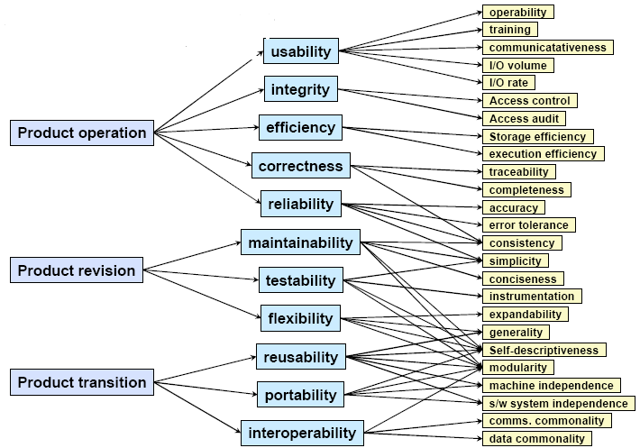
Physical Data Model Tuning (Contd.)

Slide 19
Physical Data Model Tuning (Contd.)
Usability
User interface issues such as accessibility, aesthetics and consistency
Reliability
Availability, accuracy, recoverability
Performance
Throughput, response time, recovery time, start-up time
Supportability
Testability, adaptability, maintainability, compatibility, configurability, installability, scalability and localizability

Slide 20
Physical Data Model Tuning (Contd.)
Design requirement
Constrains the design
For example: a relational database is required
Implementation requirement
Constrains the coding or construction
For example: required standards, platform or implementation language
Interface requirement
A requirement to interact with an external item
Physical requirement
A physical constraint imposed on the hardware used to house the system;
For example: shape, size and weight

Slide 21
Physical Data Model Tuning (Contd.)
Requirements | Measured as | Measurement
Performance | Response | 3seconds
Capacity | Broadness/Throughput | 100 Simultaneous Requests
Scalability | Potential for additional load | Additional 100 users
Availability | Existence | 99%
Reliability | Dependence | 1 fail per month
Manageability | Maintenance time | 1 Admin hours per day
Security | Privacy /Integrity/Audit | Can only Access

Slide 22
Physical Data Model Tuning (Contd.)
Non Functional Requirement Gathering Activities
NFR

Slide 23
Physical Data Model Tuning (Contd.)
Non-Functional Requirement -Facts :
NFRs are difficult to gather
Domain-specific requirements typically more visible
NFRs are unfamiliar to stakeholders
Few techniques for gathering NFRs
NFRs drive the foundations of Physical Model
Often relevant in a system-wide context
Can be more significant than domain-specific requirements
Consider the availability (“up time”) of a life support machine

Slide 24
Physical Data Model Tuning (Contd.)
NFR Pitfalls:
Ensure stakeholders understand the “cost” of their Requirements:
Data Analyst : "Does the product need support multiple Geographies languages"?
Customer : " If its supports its really good ”
Data Analyst: "And what about security?"
Customer: "Oh yes, the product should be secure 100%”
Data Analyst: "Tell me about your reliability and Scalability expectations"
Customer : "Definitely 24 by 7 - no down time. “
The NFR Questionnaire is technical:
Ensure stakeholders understand the value of the questionnaire
All requirements are equal:
Prioritize requirements
Ensure that the requirements are used throughout development

Slide 25
Physical Data Model Tuning (Contd.)
Requirements are not measurable:
Ensure that requirements are unambiguous and as measurable as possible
Lack of time:
Constantly remind stakeholders of the importance of these requirements
Lack of ownership:
Ensure that the System Analyst actively creates/tailors and understands the questionnaire
Talking to the wrong people:
Identify the type of stakeholder responsible for answering each question

Slide 26
Exercise
XYZ company has hired you for analyzing their data requirements . The inventory systems need to be developed and to be based on latest web technologies and need to be platform independent . They have mentioned that its should be deployed in multiple geographies and need to support 24*7 . The peak load of user community may be 1000 around 11:AM , then slowly reduces by 4 PM but the interface service need starts at 5PM and the peak data transfer can be 10 GB per day
Analyze the above requirements put down the non function requirements and generate clarification questions to understand it non functional requirements and hidden requirements better
Notes:
Platform independent , Java , linux
RDBMS – never mentioned , do they have any technical stack
Language support : what language need to support
Scalability :Distributed database / vs central database
HA :RAC /cluster
How the data being transferred ETL , flat files

Slide 27
RDBMS and Physical Data Model Design
Relational Database Management System [RDBMS] and Physical Data Model Design:
Before Design Consider DBMS Specific features
indexing
partitions
Storage parameters
Constraints
Domains or types
Block fill factors (data or index blocks)
Possibly de-normalization
Horizontal or vertical data fragmentation
OOSQL, XML or LOB support
Referential integrity
DBMS specific datatypes

Slide 28
DBMS Technology
Understand the Database Management Systems [DBMS] technology:
If you do not understand what technologies are provided by the DBMS – their capabilities and limitation, how can use them to achieve your goal?
Check out these Points
IO clustering technologies (IOT, hash or index clusters, hash tables, partitions)
Types of indexes (Btree, hash, bitmap) Parallel DML or DDL support
Sequence Numbers
OOSQL (inheritance, nested tables, types)
LOB or XML support

Slide 29
DBMS Technology (Contd.)
Check out these points:
Datatypes ( type and max sizes)
Storage ( tablespaces, block fill factors, extent sizes, transportable table spacesand so on)
Partitions or placement across file systems
Character sets ( how many Thai characters can a varchar column hold ?)
DBMS buffer block sizes (may impact max column sizes)
Online maintenance support
DBMS data caching technologies
Referential integrity support
Constraint support
Replication (requirements on tables and so on)

Slide 30
RDBMS Selection Criteria
RDBMS selection Criteria :
Selecting the right database platform depends on the needs of the organization making the acquisition. The ultimate determination will be made based on the following factors:
Budget
Database size and scalability requirements
High-availability requirements
Database functions and features
Level of support required
Non functional requirements
Customer technical stack

Slide 31
Budget
Budget
Licensing
Is the licensing open source or commercial? An open source operating system is generally acquired at either no or low costs but can lack in other areas, such as support. Today, however, the two leading open source database platforms, MySQL and PostgreSQL, both offer support contracts for their products.
Typical acquisition cost
This area represents a figure based on purchasing a single-server system housing the product listed. This system can range anywhere from a single-processor Intel server up to a multiple-processor Sun system, which is why there is a wide range in some of the offerings.

Slide 32
Requirements, Support and OS
Hardware requirements
What expense level should you expect for the typical hardware requirements for the product?
Support
What level of support can be expected for the product? In general, the commercial products have better support for their products, and third-party consultants can be more easily located.
Operating systems
What operating systems does the product support? Features This is a very small subset of some of the major features that customers look for in an RDBMS.

Slide 33
Non-Functional Requirements
Non functional Requirements
Need to look at the non functional requirements before selecting RDBMS . Example Scalability /High Availability
Customer Technical Stack /TCO:
TCO -It is the total cost of ownership -When determining the TCO on a database product, you need to consider the skill sets that will be required of the administrator who will be maintaining the database environments.
For example
How easy will it be to find a DBA who knows Oracle compared to finding one who knows PostgreSQL?
What is current DBA Skills (Oracle /SQL server)
Notes:
What about TCO? While the initial costs in software purchases are important determining factors, it is the total cost of ownership (TCO) that most companies are now focused on. This article won't attempt the complex task of comparing TCO between open source and commercial database products, but a few words can be said on the matter. When determining the TCO on a database product, you need to consider the skill sets that will be required of the administrator who will be maintaining the database environments. For example, how easy will it be to find a DBA who knows Oracle compared to finding one who knows PostgreSQL? While it may be more challenging to find open source database administrators and consultants, an organization may decide that the low up-front expenditure for an open source platform justifies the search for open source talent. However, you also have to take into account how quickly and effectively the database can be deployed and customized for the needs of your company, as well as how efficiently you can get support if there is ever a problem—which there will be. Calculating the consulting fees (or residual costs of a database administrator) and the costs of downtime and customized programming are a few of the factors that need to be considered when selecting an RDBMS.

Slide 34
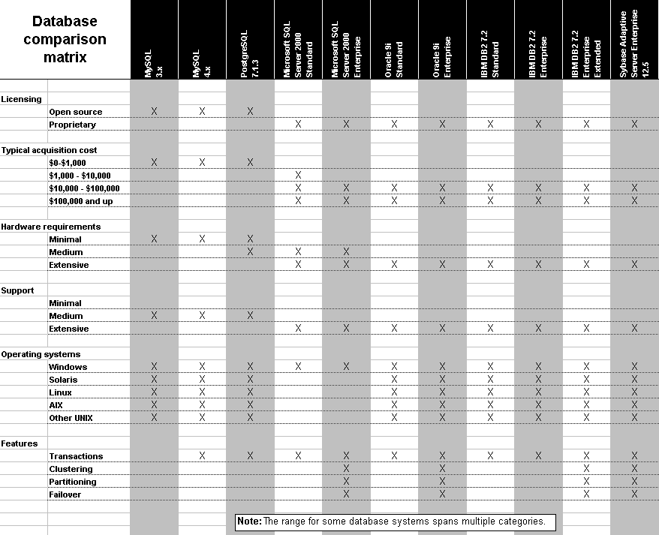
Physical Data Model Tuning (Contd.)

Slide 35
Physical Data Model Tuning Techniques
Indexing Strategy
There are two approaches to index creation:
Proactive
Reactive

Slide 36
Indexing Strategy
Proactive index creation involves anticipating which columns will be most often used for selection, joining, grouping and ordering and then building indexes over those columns.
Typically you will create an index for the most selective columns and create statistics for the least selective columns in a query. By creating an index, the optimizer knows that the column is selective and it also gives the optimizer the ability to use that index to implement the query.
In the reactive approach, indexes are created based on optimizer feedback, query implementation plan, and system performance measurements.
To perform reactive tuning, build a prototype of the proposed application without any indexes and start running some queries or build an initial set of indexes and start running the application to see what gets used and what does not. Even with a smaller database, the slow running queries will become obvious very quickly.

Slide 37
Indexing Strategy (Contd.)
Indexing Strategy
Have as few indexes as possible but as many as you need
It is useful to initially build indexes based on the database model and application(s) and not any particular query. As a starting point, consider designing basic indexes based on the following criteria:
The column is queried frequently.
Commonly used local selection columns, including columns that are dependent, such as an automobile's make and model
Commonly used join columns not considered primary or foreign key columns
A referential/ integrity constraint exists on the column.
Primary and foreign key columns based on the database model
A UNIQUE key integrity constraint exists on the column.
Create an index if you frequently want to retrieve less than 15% of the rows in a large table
Notes:
In general, you should create an index on a column in any of the following situations:
The column is queried frequently.
A referential integrity constraint exists on the column.
A UNIQUE key integrity constraint exists on the column

Slide 38
B Tree Indexing
Columns with the following characteristics are less suitable for B Tree indexing:
The column has few distinct values (for example, a column for the sex of employees).
There are many nulls in the column and you do not search on the non-null values
Some columns are strong candidates for indexing. Columns with one or more of the following characteristics are good candidates for indexing:
Values are unique in the column, or there are few duplicates.
There is a wide range of values (good for regular indexes).
There is a small range of values (good for bitmap indexes).

Slide 39
Physical Data Model Tuning Techniques
The size of a single index entry cannot exceed roughly one-half (minus some overhead) of the available space in the data block. Consult with the database administrator for assistance in determining the space required by an index.
The order in which columns are named in the CREATE INDEX command does not need to correspond to the order in which they appear in the table. However, the order of columns in the CREATE INDEX statement is significant because query performance can be affected by the order chosen. In general, you should put the column expected to be used most often first in the index
Limit the Number of Indexes for Each Table
The more indexes, the more overhead is incurred as the table is altered. When rows are inserted or deleted, all indexes on the table must be updated. When a column is updated, all indexes on the column must be updated.

Slide 40
De-normalization /Adding Redundancy
De-normalization /Adding redundancy:
De-normalization /Adding redundancy is the process of attempting to optimize the performance of a database by adding redundant data.
A normalized design will often store different but related pieces of information in separate logical tables (called relations). If these relations are stored physically as separate disk files, completing a database query that draws information from several relations (a join operation) can be slow.
The strategy for dealing with this is to keep the logical design normalized, but allow the DBMS to store additional redundant information on disk to optimize query response.
Notes:
Entity-relationship model is a data modeling method applied to model a system and its requirements in a top-down approach. This approach is commonly applied in Database design. The diagrams created applying this method are called ER diagrams.
An entity-relationship model (ERM) is a representation of structured data. Entity-relationship modeling is the process of generating these models. The end-product of the modeling process is an entity-relationship diagram (ERD) or ER diagram, a type of conceptual data model or semantic data model.
A data dictionary is a set of meta data that contains definitions and representations of data elements.
One benefit of a well-prepared data dictionary is a consistency between data items across different tables. For example: Several tables may hold telephone numbers, applying a data dictionary the format of this telephone number field will be consistent.
When an organization builds an enterprise-wide data dictionary, it may include both semantics and representational definitions for data elements. The semantic components focus on creating precise meaning of data elements. Representation definitions include how data elements are stored in a computer structure such as an integer, string or date format .Data dictionaries are one step along a pathway of creating precise semantic definitions for an organization.
The documentation of data model includes , decision logs, information about Business rules or procedures, names of the conceptual logical data model from which the current data model is derived.

Slide 41
Reason For Physical Data Model Tuning
Reason For Physical Data Model Tuning:
During physical design the database design needs to be tuned for better performance.
The denormalization is a technique to move from higher to lower normal forms of database modeling in order to speed up database access.
The valid reason exists for de-normalizing/ adding redundancy a relational design are
For Ad-hoc reporting
For Better Query Performance

Slide 42
Ad-Hoc Reporting
Ad-Hoc Reporting :
Ad-hoc reporting is the unstructured reporting and querying performed by end users.
End users are often confused when they have to join a significant number of tables.
To avoid the confusion, DBAs can create a special set of tables designed for ad-hoc reporting.
If the data is used for reporting and not online processing, you can avoid some of the problems associated with a denormalized design.

Slide 43
For Better Query Performance
For Better Query Performance :
Many critical queries and reports exist which rely upon data from more than one table. Often times these requests need to be processed in an on-line environment.
Repeating groups exist which need to be processed in a group instead of individually.
Many calculations need to be applied to one or many columns before queries can be successfully answered.
Tables need to be accessed in different ways by different users during the same timeframe.
Many large primary keys exist which are clumsy to query and consume a large amount of DASD [direct access storage device ] when carried as foreign key columns in related tables.
Certain columns are queried a large percentage of the time. Consider 60% or greater to be a cautionary number flagging denormalization as an option

Slide 44
Denormalizing/ Adding Redundancy.
Points to be considered before Denormalizing/ adding redundancy.
Can the system achieve acceptable performance without Denormalizing/ adding redundancy?
Will the performance of the system after Denormalizing/ adding redundancy still be unacceptable?
Will the system be less reliable due to denormalization/ adding redundancy?
Is the performance can be achievable by using RDBMS feature like partitioning

Slide 45
Physical Data Model Tuning Techniques
Denormalization Techniques
Adding redundant columns
Adding derived columns
Collapsing tables
Roll up – Generalization Hierarchy

Slide 46
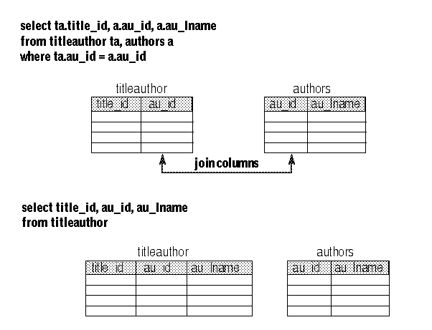
Redundant Columns
Adding Redundant Columns
The ideal candidates for redundant duplication are table columns that meet the following criteria:
The introduction of redundancy will eliminate the need to repeatedly join two tables together.
only a few columns are necessary to support the redundancy
the columns should be stable, being updated only infrequently
The columns should be used by either a large number of users or a few very important users
Disadvantages
Requires maintenance of new columns.
All changes must be made to two tables, and possibly to many rows in one of the tables.
Requires more disk space, since au_lname is duplicated.
Advantages
Adding redundant columns eliminates joins for many queries.

Slide 47
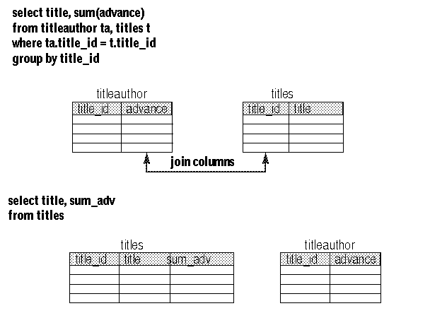
Derived Columns
Adding derived columns
This can eliminate some joins and reduce the time needed to produce aggregate values. If the cost of deriving data using complicated formulae is prohibitive then consider storing the derived data in a column instead of calculating it.
Disadvantages
when the underlying values that comprise the calculated value change, it is imperative that the stored derived data also be changed otherwise inconsistent information could be reported. This will adversely impact the effectiveness and reliability of the database.

Slide 48
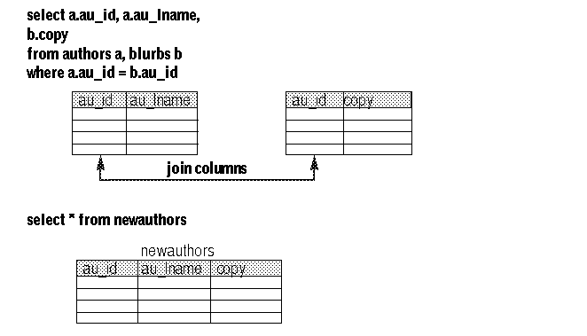
Collapsing Tables
Collapsing Tables
If most users need to see the full set of joined data from two tables, collapsing the two tables into one can improve performance by eliminating the join.
For example, users frequently need to see the author name, author ID, and the blurbs copy data at the same time. The solution is to collapse the two tables into one. The data from the two tables must be in a one-to-one relationship to collapse tables.

Slide 49
Roll Up –Generalization Hierarchy
Roll Up –Generalization Hierarchy
In the generalization hierarchy, all common attributes are assigned to the super type. The super type is also assigned an attribute, called a discriminator, whose values identify the categories of the subtypes. Attributes unique to a category, are assigned to the appropriate subtype. Each subtype also inherits the primary key of the super type. Subtypes that have only a primary key should be eliminated. Subtypes are related to the super types through a one-to-one relationship
The employee table
is now denormalized.
Here the hourly rate is
filled up only
If the employee is daily waged and
Annual salary is filled
up if the employee
is salaried employee
Before Roll Up
After Roll Up

Slide 50
Advantages /Disadvanctages of Denormalization
• Minimizing the need for joins
• Reducing the number of foreign keys on tables
• Reducing the number of indexes, saving storage space, and reducing data modification time
• Pre-computing aggregate values,
• Reducing the number of tables (in some cases)
Disadvantages of Denormalization
• It usually speeds retrieval but can slow data modification.
• It is always application-specific and needs to be reevaluated if the application changes.
• It can increase the size of tables.
• In some instances, it simplifies coding; in others, it makes coding more complex.
Advantages of Denormalization

Slide 51
Duplicating/Mirroring Tables
Duplicating/Mirroring Tables
If a group of users regularly needs only a subset of data, you can duplicate the critical table subset for that group. This requires the creation of duplicate, or mirror tables.
For example Consider an application system that has very heavy on-line traffic during the morning and early afternoon hours. This traffic consists of both querying and updating of data. Decision support processing is also performed on the same application tables during the afternoon.
This situation could be corrected by creating mirror tables. A foreground set of tables would exist for the production traffic and a background set of tables would exist for the decision support reporting.
A mechanism to periodically migrate the foreground data to background tables must be established to keep the application data synchronized.

Slide 52
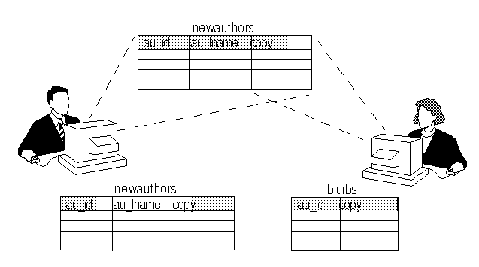
Increase Performance
Increase Performance by duplicating tables

Slide 53
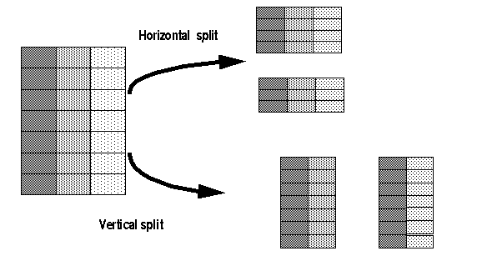
Splitting Tables
Horizontally, by placing rows in two separate tables, depending on data values in one or more columns
Vertically, by placing the primary key and some columns in one table, and placing other columns and the primary key in another table
Sometimes splitting normalized tables can improve performance. You can split tables in two ways:
Splitting Tables

Slide 54
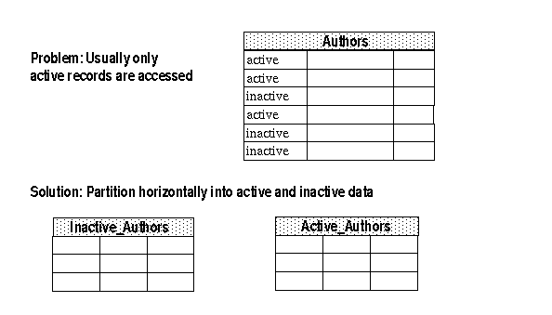
Horizontal Splitting
Use horizontal splitting in the following circumstances:
A table is large, and reducing its size reduces the number of index pages read in a query. B-tree indexes, however, are generally very flat, and you can add large numbers of rows to a table with small index keys before the B-tree requires more levels. An excessive number of index levels may be an issue with tables that have very large keys.
The table split corresponds to a natural separation of the rows, such as different geographical sites or historical vs. current data. You might choose horizontal splitting if you have a table that stores huge amounts of rarely used historical data, and your applications have high performance needs for current data in the same table.
Table splitting distributes data over the physical media (there are other ways to accomplish this goal, too).

Slide 55
Physical Data Model Tuning Techniques
Temporary processing areas :
Hard defined temporary processing areas (Stage tables)
Isolating current day transactions until end of day process is kicked off, after which data is compiled into the Full table.
Run time defined temporary processing areas (scratch tablespaces and tables)
Complete Data separation as per life time of data:
History data in separate table
Archived data in a separate table

Slide 56
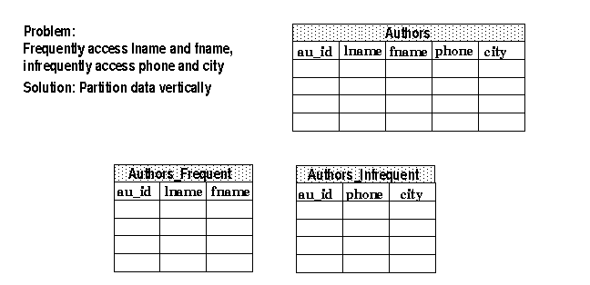
Vertical Splitting
Vertical Splitting
Use vertical splitting in the following circumstances:
Some columns are accessed more frequently than other columns.
The table has wide rows, and splitting the table reduces the number of pages that need to be read.
Vertical table splitting makes even more sense when both of the above conditions are true. When a table contains very long columns that are accessed infrequently, placing them in a separate table can greatly speed the retrieval of the more frequently used columns

Slide 57
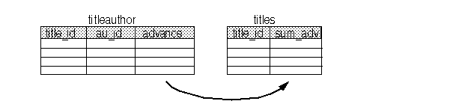
Data Redundancy
Managing Data Redundancy:
Triggers, which can update derived or duplicated data anytime the base data changes
Application logic, using transactions in each application that update denormalized data, to ensure that changes are atomic
Batch reconciliation, run at appropriate intervals, to bring the denormalized data back into agreement
Using Triggers
The sum_adv column in the titles table stores denormalized data. A trigger updates the sum_adv column whenever the advance column in titleauthor changes

Slide 58
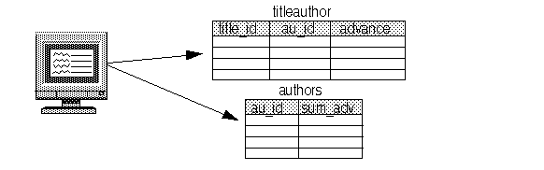
Application Logic to Manage Data Redundancy
Using Application Logic to Manage Data Redundancy
If your application has to ensure data integrity, it must ensure that the inserts, deletes, or updates to both tables occur in a single transaction

Slide 59
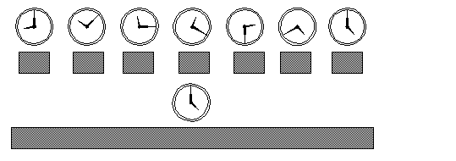
Batch Reconciliation to Manage Data Redundancy
Batch Reconciliation to Manage Data Redundancy
If 100 percent consistency is not required at all times, you can run a batch job or stored procedure during off-hours to reconcile duplicate or derived data.

Slide 60
Is Denormalization Required
Is Denormalization Required?
ask the following questions:
Have the processing requirements changed for the application such that the join criteria, timing of reports, and/or transaction throughput no longer require denormalized data?
Did a new DBMS release change performance considerations? For example, did the introduction of a new join method undo the need for pre-joined tables?
Did a new hardware release change performance considerations?
For example, does the upgrade to a new high-end processor reduce the amount of CPU such that denormalization is no longer necessary? Or did the addition of memory enable faster data access enabling data to be physically normalized?
You should measure the following criteria:
I/O saved
CPU saved
complexity of update programming
cost of returning to a normalized design

Slide 61
Is Denormalization Required (Contd.)
It is important to remember that denormalization/ adding data redundancy was initially implemented for performance reasons.
If the environment changes it is only reasonable to re-evaluate the decision. Also, it is possible that, given a changing hardware and software environment, the data redundancy may be causing performance degradation instead of performance gains.
Always monitor and periodically re-evaluate all applications which has controlled data redundancy for better performance.

Slide 62

Questions from participants

Slide 63
Test Your Understanding
What is the reason for cautious approach for index creation ?
What is the pros and cons for higher number index?
What the best indexing strategy proactive or reactive give reasons?
Type of Index selection is mostly depends on the RDBMS. State True /false.
What are the techniques to reduce physical IO?
What are the pitfalls while adding redundancy and what are the solutions ?

Slide 64
Partitioning
Partitioning Partitioning is a method of breaking up a very large table and/or its associated indexes into smaller pieces. Each piece, in essence, is either a table or an index although they are referred to as ‘partitions’ since together, they make up a larger object
Partitioning Basics
Allows for the decomposition of large tables into smaller more manageable segments
Individual segments must have same structural attributes, triggers, and constraints
Segments are allowed to manage their storage parameters individually
Partitions can be analyzed individually and in parallel
Partitions in separate table spaces can be backed up separately
Notes:
Entity-relationship model is a data modeling method applied to model a system and its requirements in a top-down approach. This approach is commonly applied in Database design. The diagrams created applying this method are called ER diagrams.
An entity-relationship model (ERM) is a representation of structured data. Entity-relationship modeling is the process of generating these models. The end-product of the modeling process is an entity-relationship diagram (ERD) or ER diagram, a type of conceptual data model or semantic data model.
A data dictionary is a set of meta data that contains definitions and representations of data elements.
One benefit of a well-prepared data dictionary is a consistency between data items across different tables. For example: Several tables may hold telephone numbers, applying a data dictionary the format of this telephone number field will be consistent.
When an organization builds an enterprise-wide data dictionary, it may include both semantics and representational definitions for data elements. The semantic components focus on creating precise meaning of data elements. Representation definitions include how data elements are stored in a computer structure such as an integer, string or date format .Data dictionaries are one step along a pathway of creating precise semantic definitions for an organization.
The documentation of data model includes , decision logs, information about Business rules or procedures, names of the conceptual logical data model from which the current data model is derived.

Slide 65
Reason of Partitioning
Why Partitioning
Performance
Faster SQL
Partition Pruning
Faster Analyze
Only analyze single partition
Logical
Application data is ‘partitioned’ (weekly for this case)
Easy to add new partition, drop oldest partition
Faster than deleting some rows from larger table
Faster than inserting new rows into larger table
Inserts /Updates /Deletes
Notes:
Entity-relationship model is a data modeling method applied to model a system and its requirements in a top-down approach. This approach is commonly applied in Database design. The diagrams created applying this method are called ER diagrams.
An entity-relationship model (ERM) is a representation of structured data. Entity-relationship modeling is the process of generating these models. The end-product of the modeling process is an entity-relationship diagram (ERD) or ER diagram, a type of conceptual data model or semantic data model.
A data dictionary is a set of meta data that contains definitions and representations of data elements.
One benefit of a well-prepared data dictionary is a consistency between data items across different tables. For example: Several tables may hold telephone numbers, applying a data dictionary the format of this telephone number field will be consistent.
When an organization builds an enterprise-wide data dictionary, it may include both semantics and representational definitions for data elements. The semantic components focus on creating precise meaning of data elements. Representation definitions include how data elements are stored in a computer structure such as an integer, string or date format .Data dictionaries are one step along a pathway of creating precise semantic definitions for an organization.
The documentation of data model includes , decision logs, information about Business rules or procedures, names of the conceptual logical data model from which the current data model is derived.

Slide 66
Partitioning and Non-Partitioning
Table_1 Partition_1
Data | Data | 10/01/2003
Data | Data | 09/01/2003
Data | Data | 08/01/2003
Data | Data | 07/01/2003
Column A Column B Date
Table_1
Column A Column B Date
Data | Data | 10/01/2003
Data | Data | 09/01/2003
Data | Data | 08/01/2003
Data | Data | 07/01/2003
Data | Data | 06/01/2003
Data | Data | 05/01/2003
Data | Data | 04/01/2003
Data | Data | 03/01/2003
Data | Data | 02/01/2003
Data | Data | 01/01/2003
Data | Data | 12/01/2002
Data | Data | 11/01/2002
Data | Data | 06/01/2003
Data | Data | 05/01/2003
Data | Data | 04/01/2003
Data | Data | 03/01/2003
Column A Column B Date
Table_1 Partition_2
Data | Data | 02/01/2003
Data | Data | 01/01/2003
Data | Data | 12/01/2002
Data | Data | 11/01/2002
Column A Column B Date
Non-Partitioned
Table_1 Partition_3
Partitioned

Slide 67
Types of Partitioning
Types of Partitioning
Range
Partition based on value of column(s) of table
Date
Part Number
SSN
Hash
Rows spread evenly across all partitions
List
Partitions based on user-specified lists of values
Composite
Partitions based on lists and range
Notes:
Range Partitioning
Partitioning by range is well suited for historical databases. However, attaining optimal performance of parallel DML on a table partitioned by range is complicated by the fact that it is not always possible to know beforehand how much data will map into a given range, and in some cases sizes of partitions may differ quite substantially, resulting in suboptimal performance of parallel DML. Alternative partitioning methods which would enable data to be partitioned with minimal skew are desirable. In addition, the specification of a range-partitioned table can be fairly complicated, especially if the partitioning key consists of multiple columns. If the main reason for partitioning a table is to attain better parallel DML performance, the ability to specify how a table is to be partitioned with a minimum of complexity would be welcomed by customers.
Oracle8i introduces a new partitioning method called Hash partitioning, which will satisfy the above requirements.
Hash Partitioning
Controls the physical placement of data across a ‘fixed’ number of partitions.
Uses a hash function on the partition column(s) to ‘stripe’ data into required partitions.
Number of partitions should be a power of 2 (2,4,16,32 and so on).
Allows data that does not lend itself to range partitioning to be easily partitioned for predominantly performance reasons (PDML, partition elimination, piece wise joins).
Only local indexes are supported with Hash partitions.

Slide 68
Advantages and Disadvantages of Partitioning
Partitioning
Advantages
Improve performance
Improve management
Load, availability
Disadvantages
Increased administration

Slide 69
NFR: Summary
Importance of NFR in Physical Model Design
Difference NFR & Functional Requirements
Points in Gathering NFR
Pitfalls on NFR
Criteria for Selecting RDBMS

Slide 70
Data Model: Summary
A Data Model is a representation of the data and data relationships of an activity.
There are 2 categories of data Model
Relational Data model
Dimensional Data Model
There are 3 types of Data model
Conceptual Data model
Logical Data Model
Physical Data Model

Slide 71
Physical Data Model Tuning Techniques: Source
http://www.learndatamodeling.com
http://www.julianbrowne.com/article/viewer/systemic-requirements
Disclaimer: Parts of the content of this course is based on the materials available from the Web sites and books listed above. The materials that can be accessed from linked sites are not maintained by Cognizant Academy and we are not responsible for the contents thereof. All trademarks, service marks, and trade names in this course are the marks of the respective owner(s).

Slide 72
You have successfully completed Physical Data Model Tuning Techniques
Click here to proceed

